Slide 1
MINI PROJECT TEAM: P7015 SAI PRAMOD NADIMPALLI KAILA SAI PRANAVA KARTHIK NIKHIL TANKALA KVR SAI SAKETH PROJECT GUIDE: T ARUN SINGH

Slide 2
IoT Based Patient Health Monitoring System using ESP8266 and Arduino.

Slide 3
ABSTRACT
Health monitoring is the major problem in today’s world. Due to lack of proper health monitoring, patient suffer from serious health issues. There are lots of IoT devices now days to monitor the health of patient over internet. Health experts are also taking advantage of these smart devices to keep an eye on their patients. With tons of new healthcare technology start-ups, IoT is rapidly revolutionizing the healthcare industry.
Internet of Things is a technological paradigm which can be incorporated in real time patient monitoring system. The review and implementation of real time monitoring of patients using biomedical sensors and microcontroller is presented where physiological parameters like heart-rate, body temperature is measured. This IoT prototype could read the pulse rate and measure the body temperature updates them to thingspeak an IoT platform.

Slide 4
IOT DEVICES USED
Arduino Nano Board
ESP8266-01 Wi-Fi Module
16x2 LCD Display
Potentiometer 10K
Pulse Sensor
LM35 Temperature Sensor
2K Resistor
1K Resistor
LED 5mm Any Colour
Connecting Wires
Breadboard

Slide 5
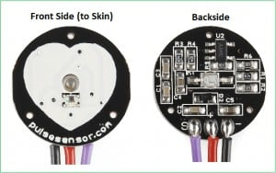
PULSE SENSOR
The Pulse Sensor is a plug-and-play heart-rate sensor for Arduino. It can be used by students, artists, athletes, makers, and game & mobile developers who want to easily incorporate live heart-rate data into their projects.
The essence is an integrated optical amplifying circuit and noise eliminating circuit sensor. Clip the Pulse Sensor to your earlobe or fingertip and plug it into your Arduino, you can ready to read heart rate. Also, it has an Arduino demo code that makes it easy to use.

Slide 6
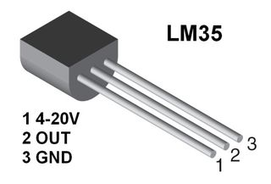
LM35 Temperature Sensor
The LM35 series are precision integrated-circuit temperature devices with an output voltage linearly-proportional to the Centigrade temperature.
The LM35 device has an advantage over linear temperature sensors calibrated in Kelvin, as the user is not required to subtract a large constant voltage from the output to obtain convenient Centigrade scaling.
The LM35 device does not require any external calibration or trimming to provide typical accuracies of ±¼°C at room temperature and ±¾°C over a full −55°C to 150°C temperature range.

Slide 7
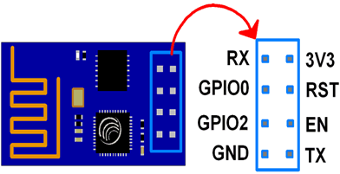
ESP8266-01 Wi-Fi Module
The ESP8266 is a very user-friendly and low-cost device to provide internet connectivity to your projects. The module can work both as an Access point (can create hotspot) and as a station (can connect to Wi-Fi), hence it can easily fetch data and upload it to the internet making the Internet of Things as easy as possible.
It can also fetch data from the internet using API’s hence your project could access any information that is available on the internet, thus making it smarter. Another exciting feature of this module is that it can be programmed using the Arduino IDE which makes it a lot more user-friendly.

Slide 8
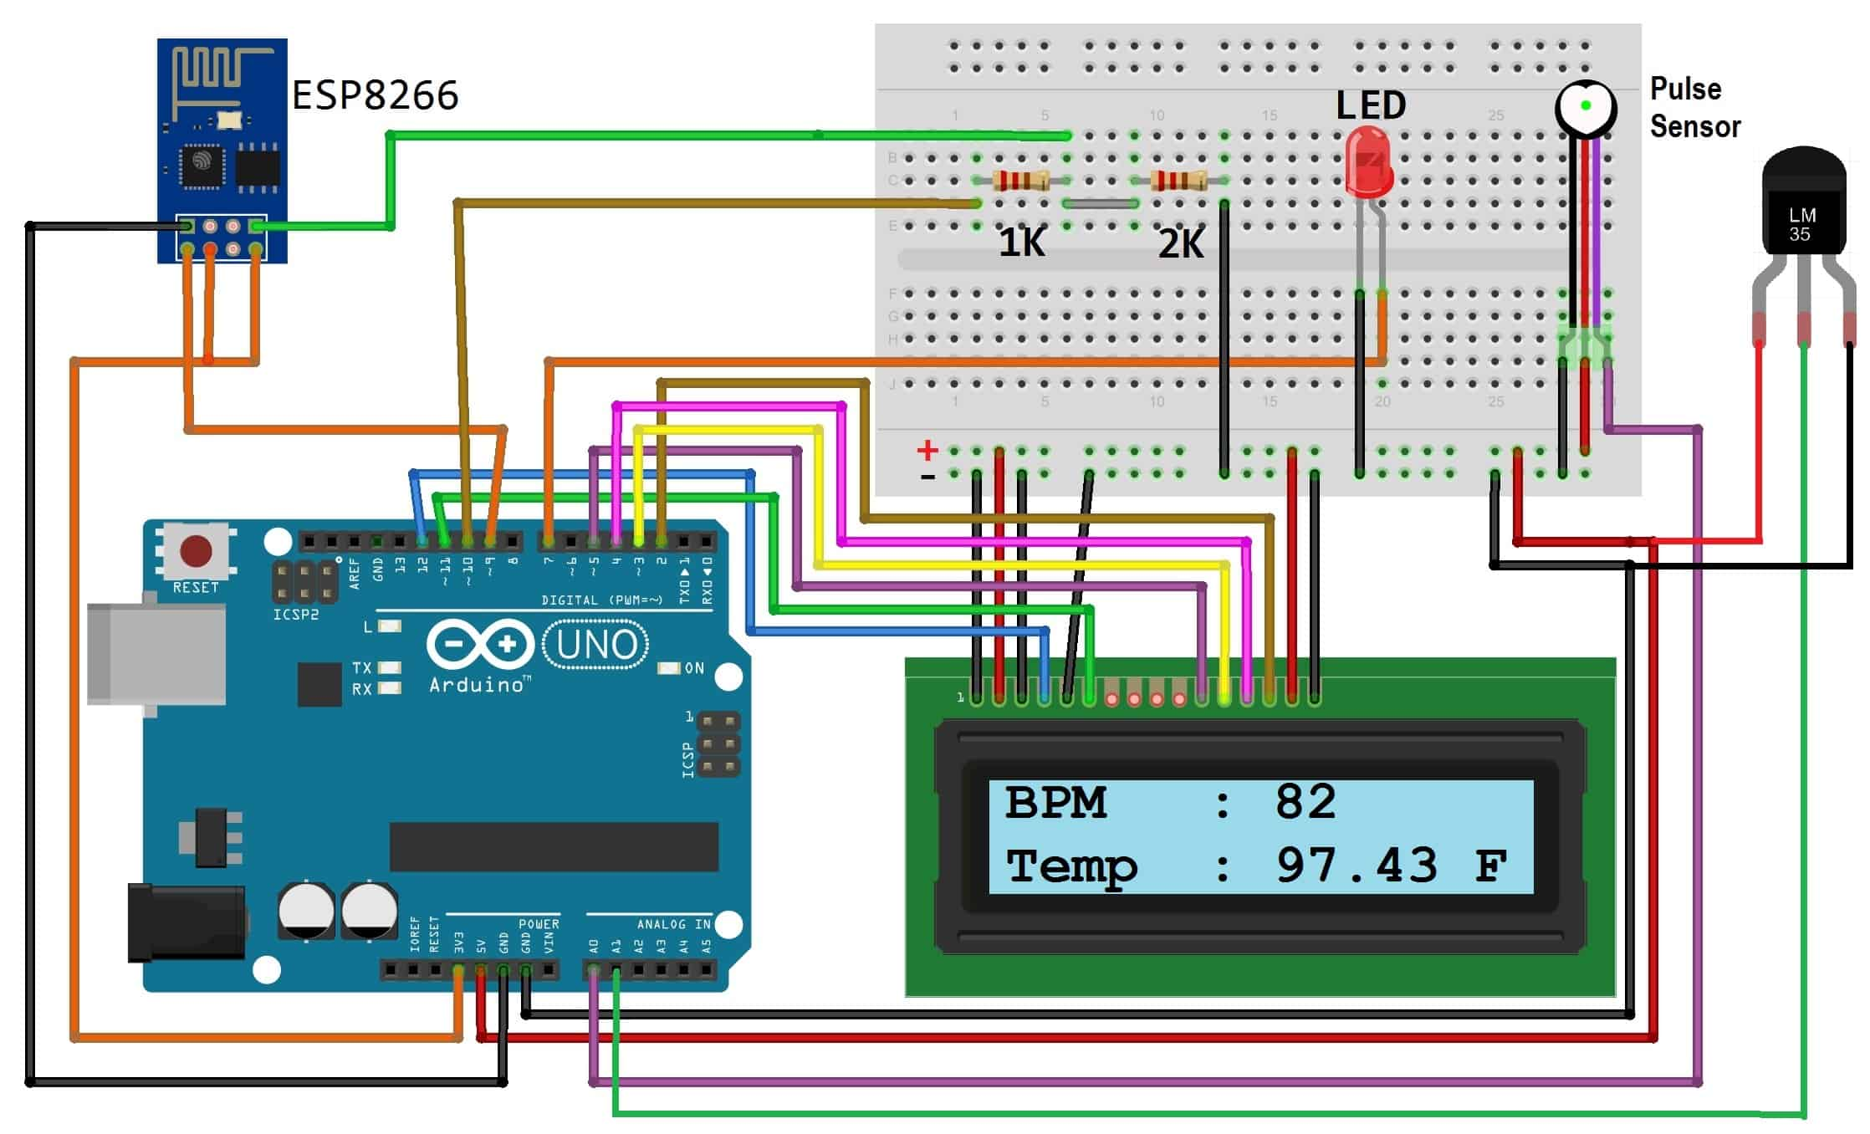
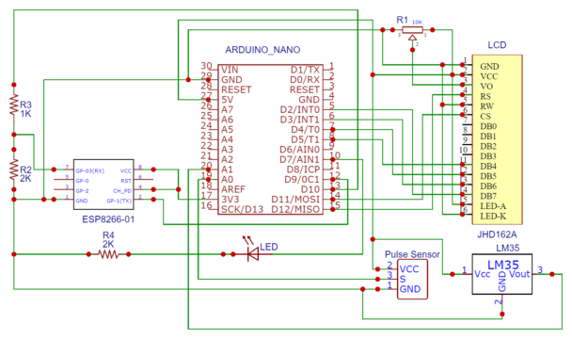
Circuit Diagram & Connections

Slide 9
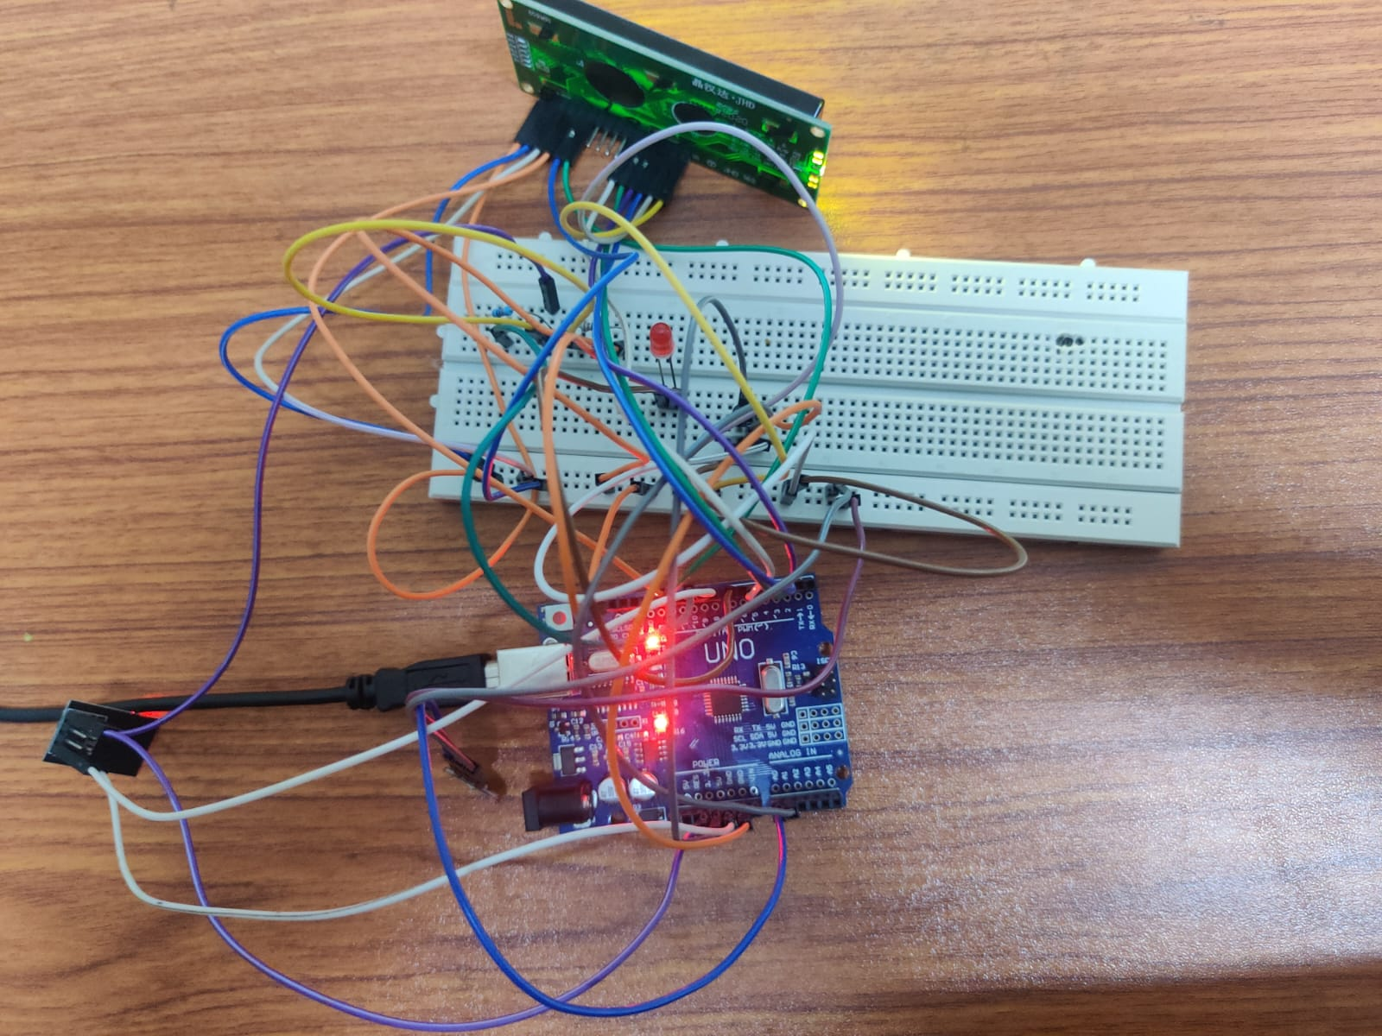
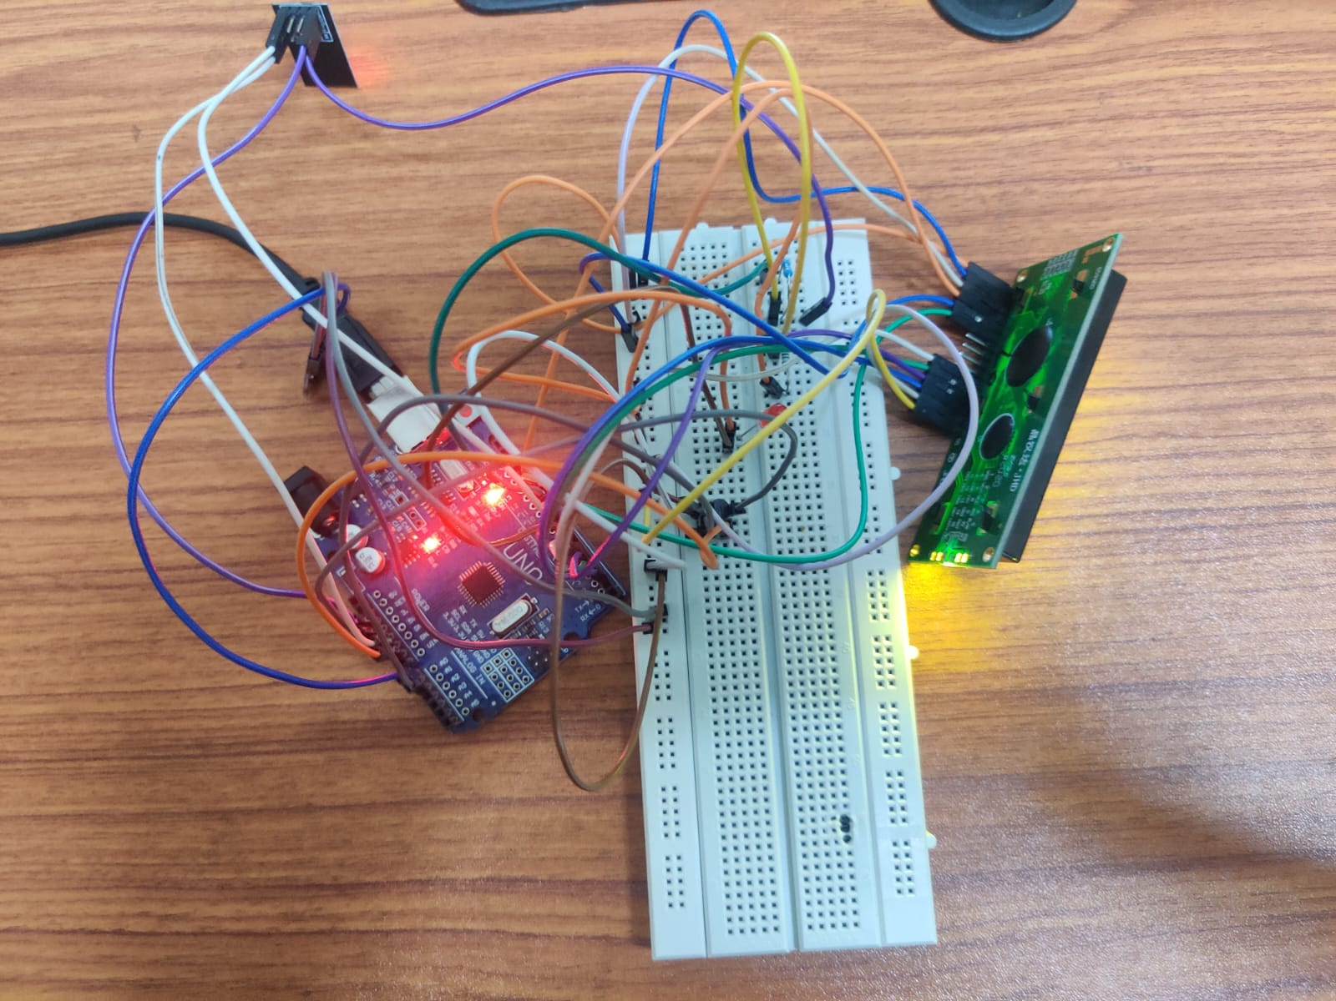
Circuit Diagram & Connections

Slide 10
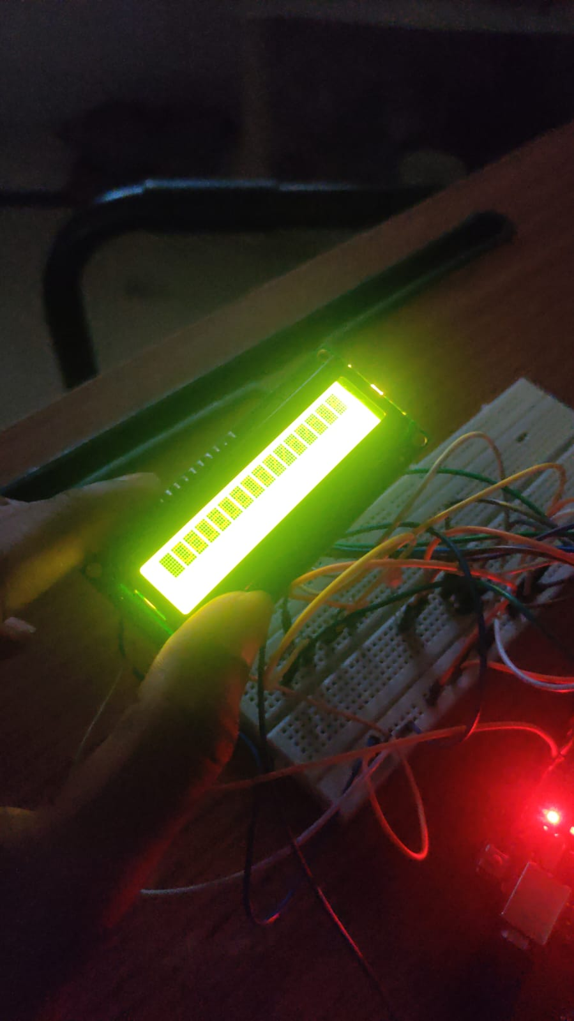
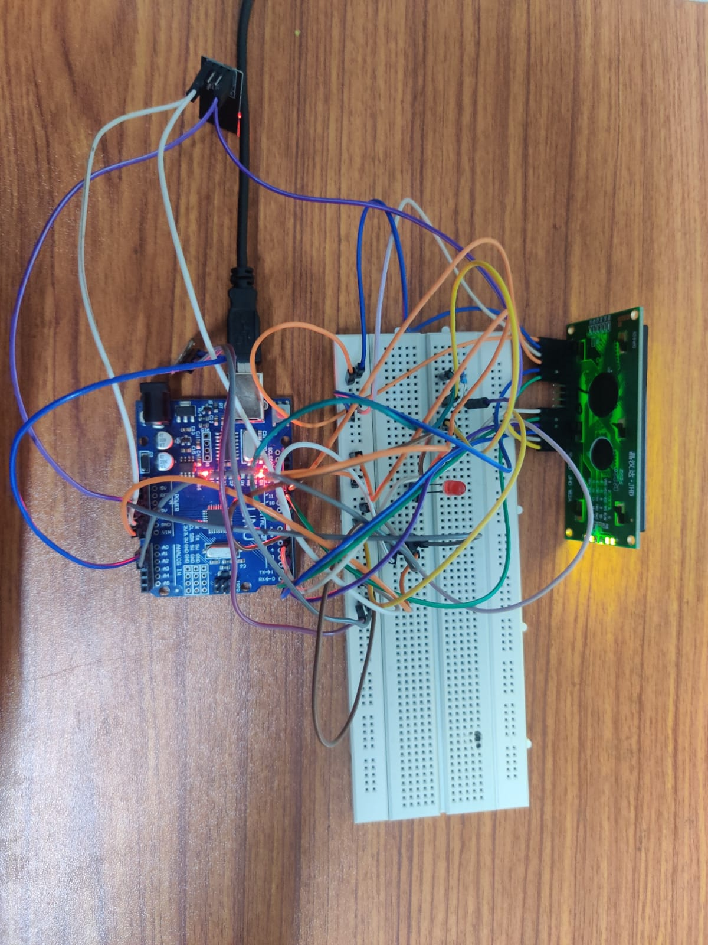
Circuit Diagram & Connections

Slide 11

ThingSpeak
ThingSpeak is an Internet of Things (IoT) platform that provides a versatile and user-friendly environment for collecting, processing, and visualizing data from a wide range of IoT devices. Developed by MathWorks, ThingSpeak offers an accessible and cloud-based solution for individuals and organizations seeking to harness the power of IoT technology.
It enables users to create IoT applications and projects with ease, offering tools for data storage, analysis, and real-time visualization.
With its open API and support for various IoT hardware, ThingSpeak empowers users to monitor and control connected devices, making it a valuable platform for applications in fields such as smart cities, agriculture, and industrial automation.

Slide 12
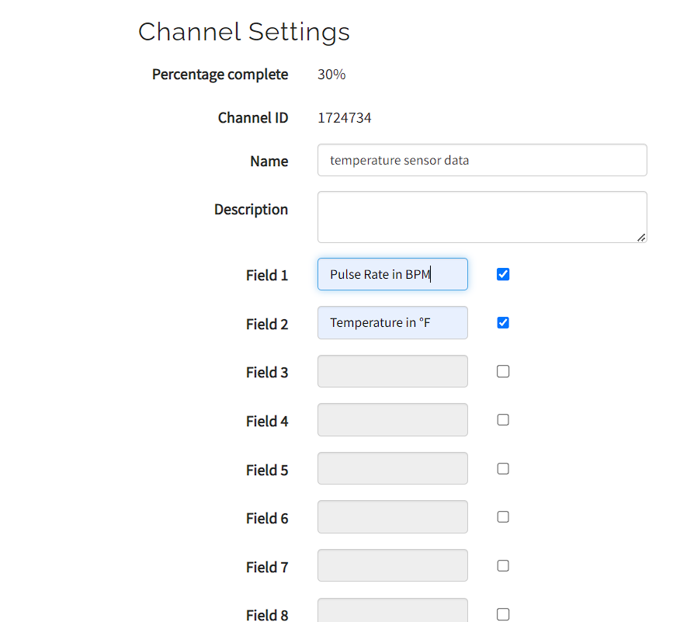
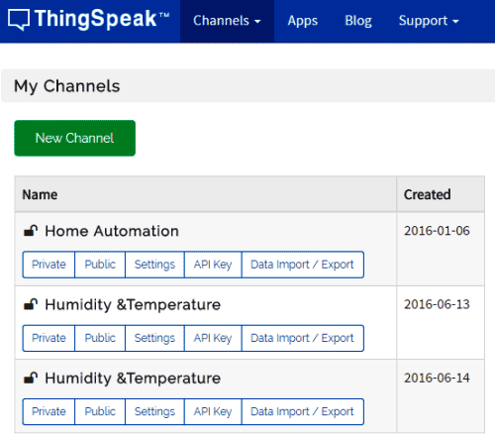
ThingSpeak
Now we create the channels, we fill in the Name and Description. Then fill ‘Pulse Rate’, and ‘Temperature’ in Fields.

Slide 13
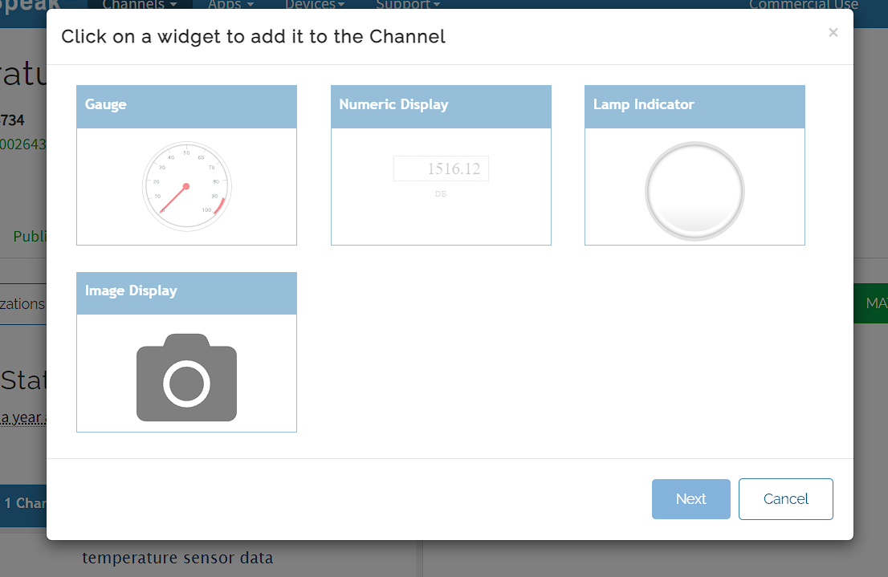
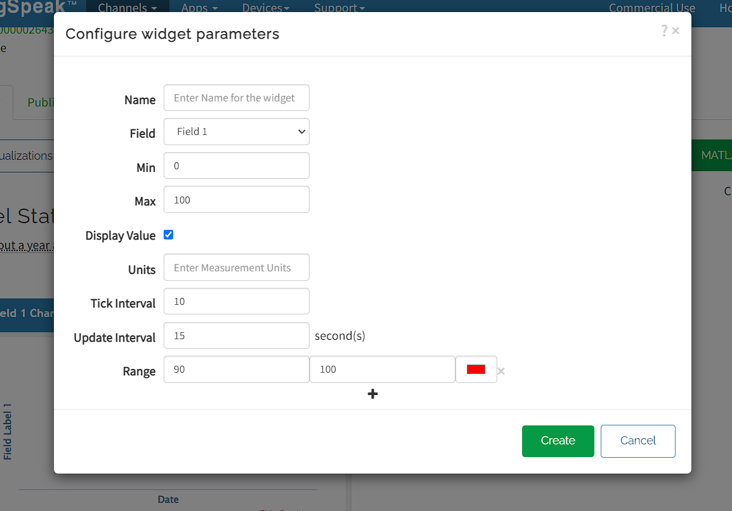
ThingSpeak
Now we add the widgets according to requirements from the below image and add all the specifications of the sensor.

Slide 14
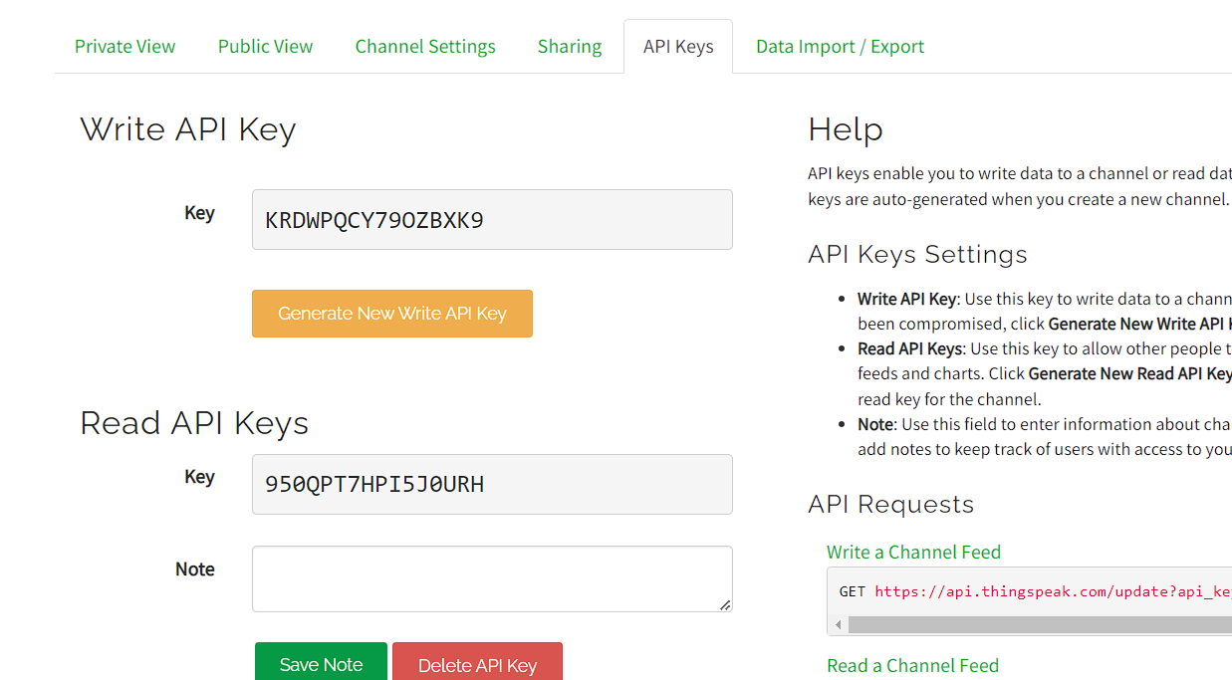
ThingSpeak
API key plays the conversation between the client and the server

Slide 15
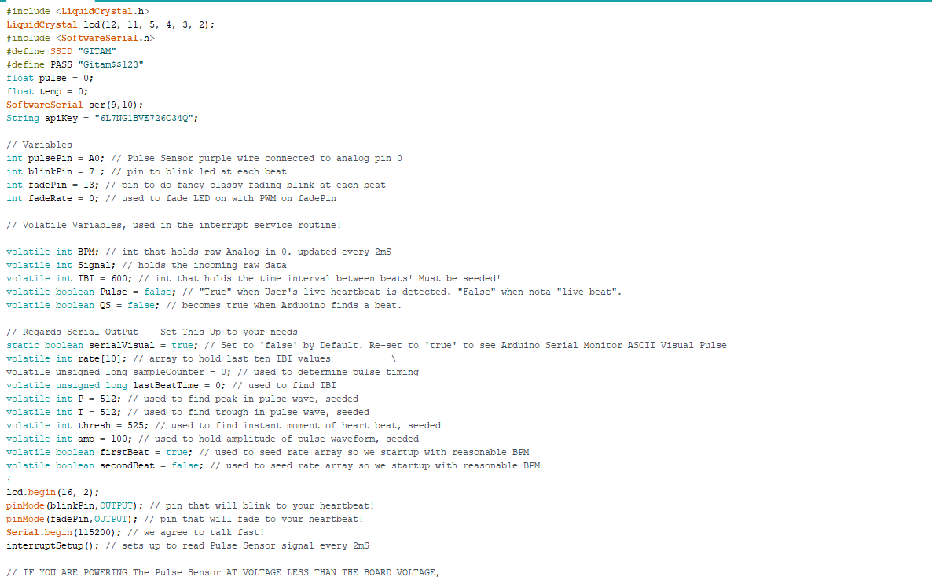
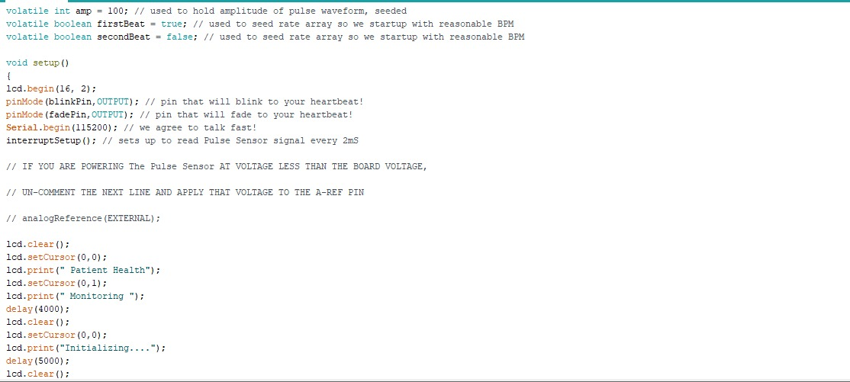
CODE

Slide 16
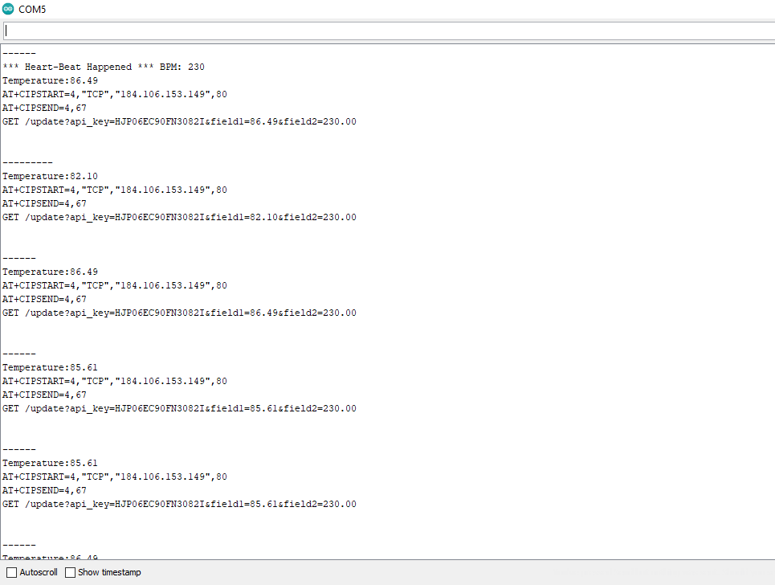
OUTPUT

Slide 17
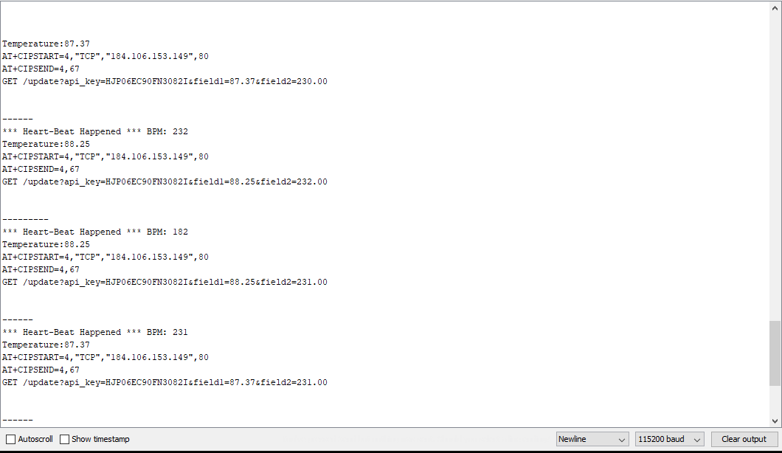
OUTPUT

Slide 18
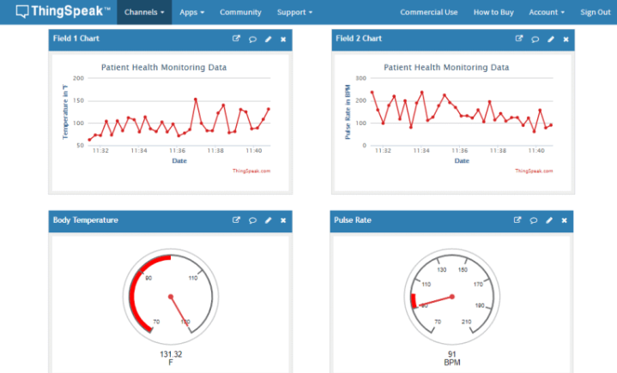
OUTPUT

Slide 19



